Slide 1
Emerging Threats to Infrastructure
Jorge Orchilles
Security Analyst
North Central Florida IIA
Notes:
Titled Emerging Threats to Infrastructure and NOT Advanced Persistent Threat. APT will be highlighted but by definition only refer to attacks coming from China.
Prepared for North Central Florida Institute of Internal Auditors.

Slide 2
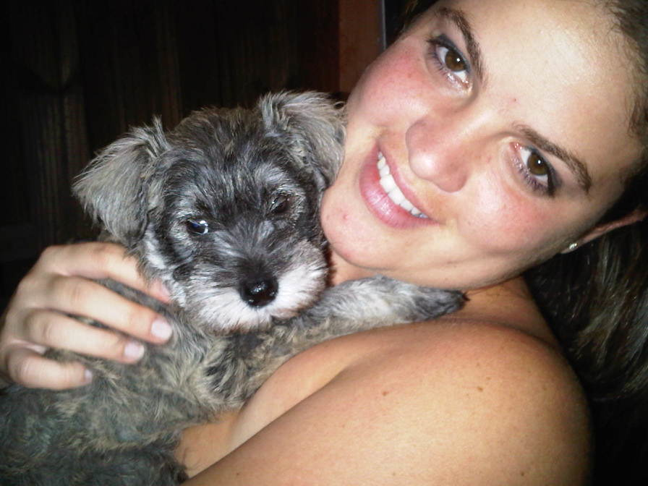
My new hobby

Slide 3
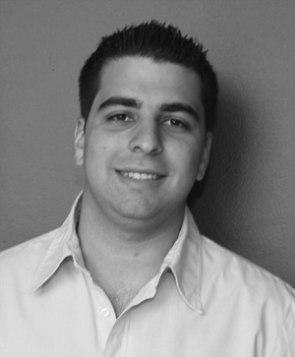
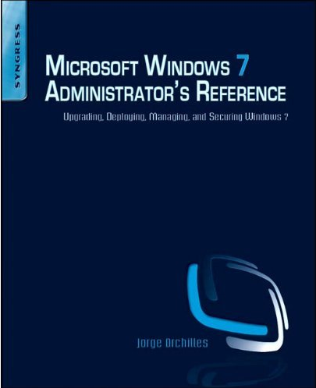
About Your Speaker
Information * for over 8 years
Security Analyst – Fortune 20
Consultant by night – Orchilles Consulting
Master of Science and BBA in Management Information Systems – Florida International University
Author – Microsoft Windows 7 Administrator’s Reference (Syngress)
Certifications – GCIH, CEH, CICP, CCDA, CSSDS, MCTS, MCP, Security+
Organizations:
VP of South Florida ISSA
Hack Miami
OWASP
InfraGard
Miami Electronic Crimes Task Force
Notes:
Jorge Orchilles, author of Microsoft Windows 7 Administrator’s Reference, holds a Master’s of Science in Management Information Systems from Florida International University, is currently a Security Analyst at a Fortune 20 financial institution, and serves as Vice President of the South Florida ISSA Chapter.

Slide 4






Ex-Terremark
Leading global provider of managed IT services
Colocation
Network & Connectivity
Managed Hosting
Cloud Computing
Information Security
Data Services & Disaster Recovery
Access to more than 160 global network carriers
VMware Service Provider of the Year 2009
Notes:
Terremark Worldwide (NASDAQ:TMRK) is a leading global provider of IT infrastructure services delivered on the industry's most robust and advanced technology platform. Leveraging data centers in the United States, Europe and Latin America with access to massive and diverse network connectivity, Terremark delivers government and enterprise customers a comprehensive suite of managed solutions including managed hosting, colocation, disaster recovery, security, data storage and cloud computing services. Terremark's Enterprise Cloud computing architecture delivers the agility, scale and economic benefits of cloud computing to mission-critical enterprise and Web 2.0 applications and its DigitalOps&reg; service platform combines end-to-end systems management workflow with a comprehensive customer portal. More information about Terremark Worldwide can be found at http://www.terremark.com.

Slide 5
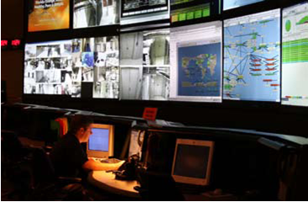
Security Operations Center (SOC)
24/7 monitoring
IDS/IPS
Log Aggregation
Network Analysis
Deep Packet Inspection
Managed Firewall
Network Forensics
DB Monitoring
Scanning
File integrity monitoring
Compliance reporting
Notes:
Terremark’s Security Operations Center (SOC) is part of Terremark Operations and located in the Network Operations Center in the NAP of the Americas. Our team of skilled security analysts monitor our customers and internal information security 24/7.
The slide points out most of the security solutions we provide.
We offer all of these quality services to customers and are considered a Managed Security Service Provider (MSSP).

Slide 6



Industry Reports
SANS Top Cyber Security Threat
Verizon Business 2010 Data Breach Study
Symantec State of Security Report
US Cert
SANS Internet Storm Center – http://isc.sans.org/
Notes:
Information Security reports are released at different intervals throughout the year depending on the sponsor. Generally these reports are by vendors and show their results. The favored reports are those by vendor neutral entities such as the SANS, US Cert, and Verizon business which deal with actual data breaches:
Verizon: http://newscenter.verizon.com/press-releases/verizon/2009/verizon-business-2009-data.html
SANS Top Security Risk: http://www.sans.org/top-cyber-security-risks/
SANS Internet Storm Center: http://isc.sans.org/
Symantec State of Security Report - http://www.symantec.com/about/news/resources/press_kits/detail.jsp?pkid=sesreport2010
US Cert - http://www.us-cert.gov/

Slide 7
News and Media
Resources:
Data Loss Database - http://datalossdb.org/
PrivacyRights.org
Some that were reported:
Heartland Payment Systems (130+ million – 1/2009)
Oklahoma Dept of Human Service (1 million – 4/2009)
University of California (160,000 – 5/2009)
Network Solutions (573,000 – 7/2009)
U.S. Military Veterans Administration (76 million – 10/2009)
BlueCross BlueShield of Tennessee (187,000 – 10/2009)
Google (1/2010)
Many others?
Stuxnet (2010)
Notes:
DataLossDB is a research project aimed at documenting known and reported data loss incidents and data breaches world-wide.
PrivacyRights.org - A nonprofit consumer education and advocacy project whose purpose is to advocate for consumers' privacy rights in public policy proceedings.

Slide 8

Agenda
Know your enemy
Who is your enemy?
What are they after?
How are they attacking?
Know yourself
What are you defending?
Who are you defending?
How do we defend?
It is said that if you know your enemies and know yourself, you will not be imperiled in a hundred battles; if you do not know your enemies but do know yourself, you will win one and lose one; if you do not know your enemies nor yourself, you will be imperiled in every single battle. – Sun Tzu
Notes:
Sun Tzu:
It is said that if you know your enemies and know yourself, you will not be imperiled in a hundred battles; if you do not know your enemies but do know yourself, you will win one and lose one; if you do not know your enemies nor yourself, you will be imperiled in every single battle.
Art of War for Security Managers: http://www.elsevier.com/wps/find/bookdescription.cws_home/712202/description#description
To properly analyze emerging threats we need to answer a few questions:
Who is attacking? Know your enemy
Know what your enemy is after.
Know how your enemy is attacking.

Slide 9
Know your enemy
Notes:
This slide is reserved for a video courtesy of Radware demonstrating hackers in the past and hackers today. In 1988, kids played computer games and figured out how to cheat. It was a lot of fun. Then as they got older they got good grades in school, not because they earned them but because they hacked the school computers. While they were at it they would deface web sites too for bragging rights. Today, today is different. Today hackers want money and they are going after your financial information.

Slide 10
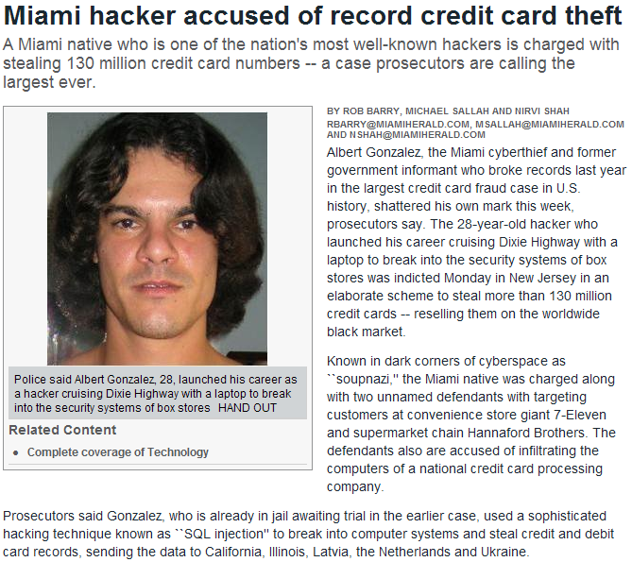

Who is attacking?
Organized Crime
Nation-States
Well Meaning Insider
Malicious Insider
Script Kiddies
Notes:
Organized Crime - 90% of records lost in 2008 involved organized crime targeting corporate information according to Symantec
Nation-States are now behind some of the most advanced malware we have seen!
Well Meaning Insiders – includes laptops and USB flash drives lost with data
Malicious Insiders –
Script Kiddies and automated attacks is the majority of the attacks your IDS and Anti-virus will see and stop

Slide 11
Motivation based on botnets
Vandalism and publicity
“Hacktivism”
Financially motivated
Kracken
(Botnet)
2008
Zues
(Botnet)
2008 - 2010
Srizbi
(Botnet)
2007
Attack
Risk
Rustock
(Botnet)
2007
July 2009
Cyber Attacks
US & Korea
Storm
(Botnet)
2007
CodeRed
(Defacing IIS web servers)
2001
Blaster
(Attacking Microsoft web site)
2003
Nimda
(Installed Trojan)
2001
Estonia’s Web Sites
DoS
2007
Slammer
(Attacking SQL websites)
2003
Agobot
(DoS Botnet)
Republican
website DoS
2004
Georgia Web sites
DoS
2008
2001
2005
2010
Notes:
Botnet attacks show a lot about hacker motivation. Back in the early 2000’s it was more for vandalism, publicity, and hacktivism. In the late 2000’s a trend began to financially motivated attacks. “If my competition is down for 1 day, I get all their business”

Slide 12
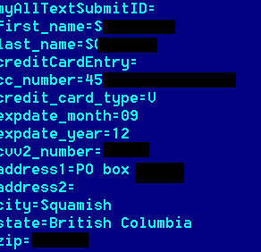
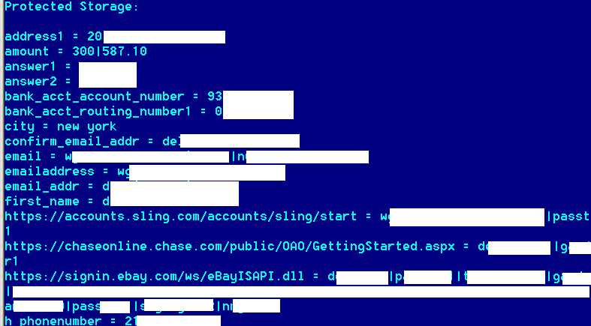
Output of Zeus Logs

Slide 13
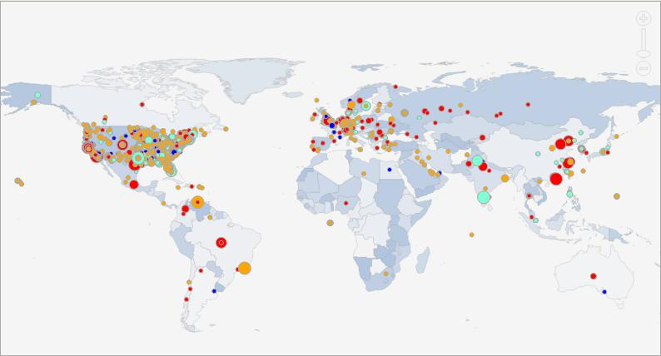
From where are they attacking?
Notes:
Where the attacks are coming from? Everywhere! Attackers generally do not attack from home, they proxy and bounce from compromised host to compromised host to hide identity.
This is a snapshot of the events in the past 24 hours on Tuesday March 16, 2010

Slide 14
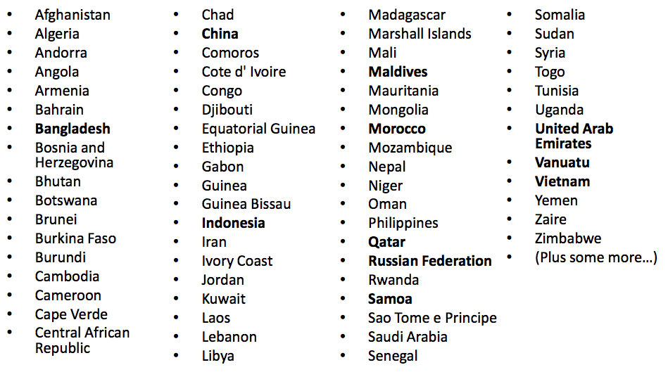
No Extradition
Notes:
One of the largest problems I see is that not all countries have laws against hacking. The ones that do may not have jurisdiction into countries that do not.

Slide 15
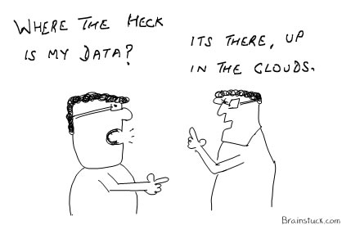
What are they after? What are we defending?
Notes:
Is anyone evaluating or looking at Cloud Computing? What is one of the main questions when considering this move? Where is my data?
Data is what they attackers of after, whether it is PII, credit card numbers, databases, etc they are after the data. Hacktivism might be after infrastructure to take it down but the biggest concern is loosing data.

Slide 16
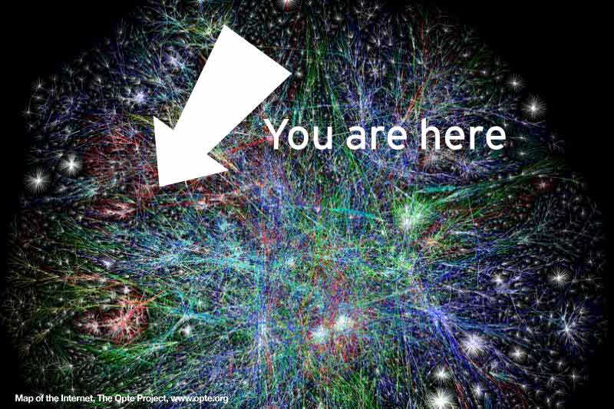
Know yourself
Users
They are going to click on EVERYTHING
On a mission to explore the entire Internet.
The Internet is so massively big and EVIL!
Security is not a major concern
They never get in trouble
“It was just a pop-up”
They “think” they know when they are being attacked
Notes:
The weakest link in any security assessment is the user. The user can be socially engineered to do things they shouldn’t, click on things they shouldn’t and eventually give an attacker access to data that they should not have.
A snapshot of a map of the internet. It is HUGE and many areas are evil!

Slide 17
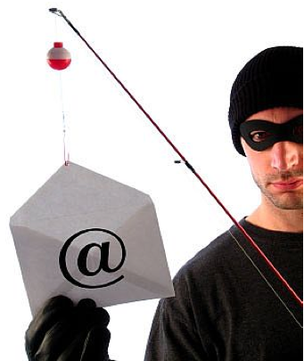
Anatomy of an Attack
Reconnaissance\ Information Gathering
Social Networks
Job Postings
Scanning
Targeted against users
Spear Phishing
Spam
Social Networks
Exploiting – initial intrusion into network
Maintaining Access
Establish backdoor – outbound connection
Obtain user credentials
Install various malware
Privilege escalation/ Lateral Movement/ Data Exfiltration
Erase tracks
Notes:
This is how attacks work and have always worked. The methods used within each point is what changes. The SANS SEC504 class that prepares you for the GIAC Certified Incident Handler certification titled Hacker Techniques, Exploits, and Incident Response is based on these main points.
The main method stays the same, the ways of doing each aspect is what changes and emerges and what we will focus on in this presentation.

Slide 18
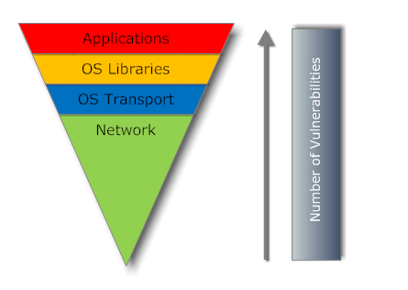
How are they attacking?
Application vulnerabilities exceed OS vulnerabilities
Adobe Reader 0 days
Adobe Flash 0 days
Apple QuickTime
Microsoft Office
Growing Malware
Notes:
Microsoft and other Operating Systems have been diligent about releasing secure code and patches to vulnerabilities in a timely fashion. Users and IT have also been keeping up to date and patching these systems on a regular basis. Therefore, the weakest link becomes the third party applications installed on these systems. Adobe has been extremely bad about patching their vulnerable software and has horrible coding practice with what is speculated to be no concern for security. The same is true for other third party applications and developers.

Slide 19
Growing Malware Threat
New threats per day: ~30,000
New signatures per day:
~3,500
Total as of September 1, 2009: 2,739,919
Signature based Anti-Virus and IDS will not catch it all!
Notes:
Malware is an increasing threat. Over 30,000 new malware variants are released per day. In this presentation we will create 1 more for the purpose of proving this point. The malware will not leave the sandbox/demo environment.
Anti-virus vendors cannot keep up with the growing threat. The growth is incredible.

Slide 20
How are they attacking?
Professionally targeted to weakest links
Poorly configured Web servers
Vulnerable publishing platforms
Un-patched Internet-facing databases
Obfuscated JavaScript code inserted on hacked Web pages
Redirects to remote server hosting exploits
Serves custom malware based on Windows OS version, browser version, patch level, vulnerable third party apps
Fires exploits simultaneously at IE, WinZip, Java, QuickTime, ActiveX controls, even Firefox … until exploit hits target
Payload: Backdoor Trojans, password stealers, banker Trojans, spam bots
This is the work of highly skilled, well-organized cyber criminals
Notes:
Attackers today are cyber-criminals looking to make money off of your data. Attackers no longer target the OS. They are after applications that contain data that can be used to make money! Threats come from many vectors: physical vectors (floppy disk, USB drives, CD’s), Email vectors (spam, web redirection, phishing), Web vectors (drive-by downloads, malicious sites, liability). And they are targeting WEB sites as the weakest links.
The primary web vulnerabilities, SQL Injections and Cross-site Scripting (XSS) make up 80% of the exploited vulnerabilities. Because of these, your web site could be launching malware, serving malicious content to vulnerable client side applications. If it’s poorly configured to keep hackers out, hackers will plant malicious code that proliferates malware to unsuspecting surfers. Not only will your users be hurt but Google will see it and block your website until you clean it, resulting in damage to your business. Vulnerable databases that hold user data can also be hacked. Software that creates a website, like Drupal, WordPress (the most insecure), and others. Your website is vulnerable because of these platforms. Must keep systems updated and patched.
Obfuscated (hidden, obscure) Javascript, hidden in a legitimate website, redirects users connections to another server (in Astonia, Russia). This happens in background without your knowledge. You are fingerprinted, shows apps, OS, patch levels, etc., and an exploit is triggered to target a found vulnerability.
A backdoor trojan is loaded which gives the hacker access to put other things on your system, i.e., banker Trojans (programed with list of 100 banks – when you go to your bank the Trojan kicks in because it’s on the list and it captures your info and uploads it to a remote server.

Slide 21
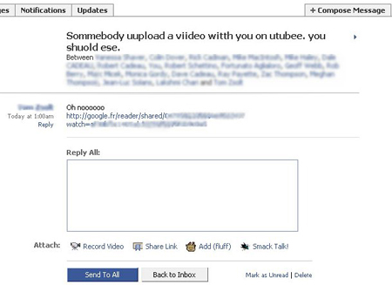
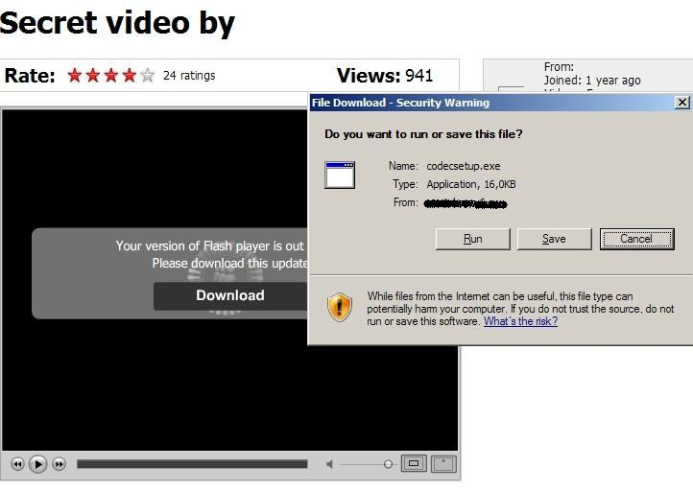
A Facebook Attack In Action
Net-Worm.Win32.Koobface
Created in July 2008
Variants still squirming in 2009
Net-worm that exploits trust on Facebook and Myspace
Notes:
Koobface. A network worm running on Windows systems. There are 60 new variants today since july 2008.
Originally found on facebook but now it’s occurring on twitter and myspace. Exploits this trusted site kind of thing.
Here’s what it looks like. Notice the redirector says google to add more trust.
You click on the link and it looks like Youtube. Then it tells you that you need to update your flashplayer. If you run it, you get the malware. When you get it, you then start sending the same message to all of your friends and family. Makes you very popular!!

Slide 22
Live Demo
Attacker – BackTrack 4 LiveCD and SET
Perform recon on company to obtain email address of IIA presentation participant
Create malicious PDF file and configure it to call attacker when opened.
Email IIA presentation participant
Victim
Running Windows XP Federal Desktop Core Configuration with all Windows Updates
Running Adobe Reader 9.0 latest version is 9.4.0
User is very conscience about security and does not open files from people he/she does not know.
Will open IIA presentation because it has very valuable material
Pray to demo gods!
Notes:
Shiatata_ga_nai – Chinese for “you can not do anything about it”

Slide 23
How do we let this happen?
Lack of user awareness
Poorly protected infrastructure
Patch everything, not just OS but applications
Poorly protected data
Poorly enforced IT/Security Policy
Security tools deployed don’t just work

Slide 24
What is Advanced Persistent Threat?
Term coined by U.S. Air Force for Chinese Related Intrusions
Attacks conducted by well funded and organized groups
Professionals not script kiddies!
Motivation
Economic, Financial, and Political against US government and commercial entities
Targeted attacks
Custom Malware
Constant Aggressor
Network Occupation
Persistent Access to network
This is not new! Over 5 years seeing this activity!

Slide 25
Why is APT Successful?
Victims and targets are not aware of these attacks
Good that Google disclosed?
Information Security Defenses Don’t Work!
APT evades:
Anti-Virus signatures
IDS signatures
Network appliances (firewall, IPS, etc)
Security Operations?
APT remains undetected once inside the network!

Slide 26
Case Study: Heartland
They were PCI Compliant!
~ 130 million credit cards compromised
Notified by 3rd party!
Attackers had persistent long-term access
Possible initial entrance through WEP or even open Wireless Access Point.
Used targeted (custom) malware to propagate
They were PCI Compliant!!
Why was the only “early indicator” the resulting fraud? -Anton Chuvakin

Slide 27
Compliance ≠ Security
Blame TrustWave?
No way! Not fair to TrustWave!
Was compliance or PCI designed to make systems secure?
Is that even possible?
Although Compliance is not Security are more companies more secure now because of compliance?
Is this even a compliance issue?

Slide 28
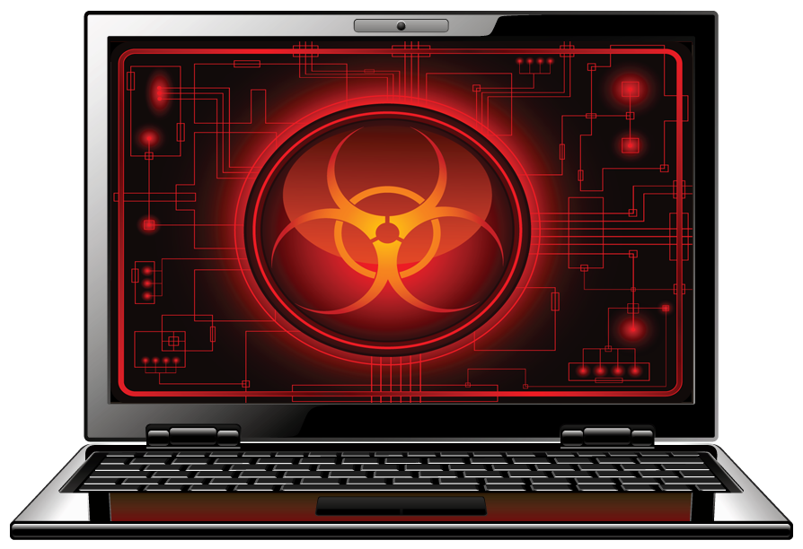
Case Study - Aurora
Targeted Attacks
Used Social Engineering
Followed by 0-day on IE6
Lots of research, time, and money
Wasn’t just Google! Many, many, others

Slide 29
Case Study - Stuxnet
Very Targeted!
SCADA systems
Programmable Logic Controllers
Specific models: s7-300 and s7-400
Specific configuration in these models
4 different attack vectors – 0day, USB
Uses rootkit and machines become part of botnet
Lots of research, time, and money (nation-state involvement)
Difficult to detect - intercepts commands, modifies, and continues to send
Sloppy

Slide 30
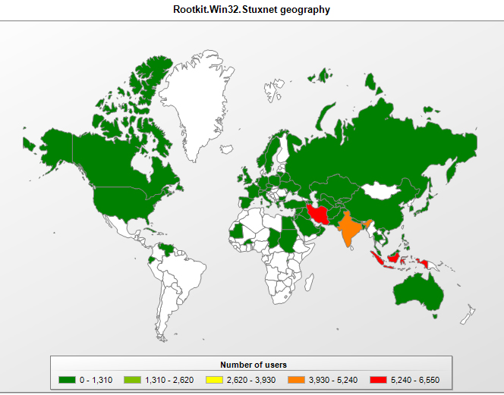
Stuxnet Geographical Distribution
Notes:
Iran was the most hit by Stuxnet. Many say it was targeting their newest nuclear facility. Analysts found Hebrew in the code but it may have been planted.

Slide 31
Stuxnet vs. Aurora
Both used 0day attacks which required funded and lots of research
Aurora was for IE6
Stuxnet was on Windows up to 7!
Stuxnet was more targeted and advanced in bypassing security tools:
Uses signed drivers
Uses Rootkit
Aurora is a trojan while Stuxnet is a worm
Notes:
Both were targeted and complex.

Slide 32
The Challenge!
Are you willing to be proactive about security?
Ask these 5 key questions:
What data is being collected, transacted on, transmitted, or stored, and for what purpose?
How are authentication and authorization being accomplished?
What are the communications channels between each component of the system and do they cross any network boundaries?
Does the solution involve: an Application Service Provider, data in the Cloud, an externally facing service?
Are there any regulatory laws, statutes, and/or compliance that must be met?

Slide 33
You can make a difference!
Think architecturally about security
Follow Project Life Cycle process
Ask the 5 key questions on all projects
Ensure implementation of requirements
Grow your security knowledge
Evangelize information security in your area

Slide 34
Tips for Computer use at Home
Separate computer for online banking
Separate computer for the kids
Set strong administrator passwords
Use a second limited user account
Turn the computer off when not using it
Apply operating system AND application patches
Don’t use wireless for online banking
Use a strong password for online banking accounts and do not use this password ANYWHERE else

Slide 35
Conclusion
You will get compromised!
Plan accordingly – incident response planning
Focus on securing the data and the access to it
Secure the user environment
Patch OS and applications
User awareness training
Not just a form to sign
Test the users!

Slide 36

Questions?
Jorge Orchilles
jorge@orchilles.com
Twitter: jorgeorchilles
http://www.orchilles.com

